Slide 1

Pl nt
Current work, values, and project goals
CS-305-101
Marshall University
Shane Snodgrass, Matthew Williams, Robert Peterson, Logan Waller, Deven Miller
Notes:
Introduce the team and the project name. One sentence: Plant is a social platform where popular posts grow into their own forums.

Slide 2
What is our Platform?
A social media platform that promotes natural growth of post into forums with a community built around them
How is it Different?
Plant allows posts to evolve relationally with the interest shown in them from the community, rather than organizational effort
Content shown to the user is defined by the user through their interest, interactions, and preferences
Notes:
Scope and vision. Key line: posts evolve into forums based on community interest, not manual organization. Content is shaped by the user's own interests and interactions.

Slide 3
What are our objectives?
Plant's objective is to create a social media platform with content that the user is actually interested in and can form a community around with others that share similar interest
How will we track this?
The metrics that will be used to measure success include :
  # of posts that "graduate" to forums per week
  Average lifespan after a forum spawns
  User engagement rates
  User growth rate
  Quality survey results from users
Notes:
content users actually care about, and communities around it. Name the metrics quickly (posts graduating to forums per week, forum lifespan, engagement, growth, survey quality). Don't read every bullet.

Slide 4
How is this Business Sustainable?
1
Advertising
2
Data
3
Premium
Personal ads: pay to promote your forum on Explore, in its category
Business ads: tiered reach, products only
Usage data (no personal info) sold to brokers
Forums visited, common queries, rough location, post interactions
Subscription: animated profile image, avatar frames, animated backgrounds, user tags
Ad-free mode: ads only on Explore
Notes:
Three revenue streams: ads (personal and business), anonymized data, and premium subscriptions. Keep it to one sentence each.

Slide 5
Major Features
1
2
3
Interactive dashboard
Personal accounts
Individual profile pages
4
5
6
Post-to-forum progression
Direct messaging
Favorites & Recent
7
8
9
Post/forum query bar
Explore page
Business ad accounts
Notes:
This is what you'll see at the end of the semester. Highlight post-to-forum progression as the headline feature, then move on.

Slide 6
Key User Stories
Post-to-Forum Spinoff
1
As a user, I want a post to spin off into its own forum once it gains traction, so people with similar interests can interact with it.
Personalized Feed
2
As a user, I want a feed based on my interests and friends, so I stay connected with people I know while discovering new communities.
Moderation Tools
3
As a forum moderator, I want to review reports, mute or ban disruptive users, and manage forum settings, so my community stays safe and on-topic.
Promoted Posts
4
As a business user, I want to run promoted product posts in relevant tech and gaming forums, so our products reach likely buyers.
Kids Mode
5
As a user, I want to restrict access time and communities for underage users, so parents can limit access as necessary.
Notes:
Five stories chosen because they are unique to Plant, not generic account features. Lead with Post-to-Forum (the core idea), then feed, moderation, ads, and kids mode. Spend ~15 seconds per story; don't read the full sentence, paraphrase it.

Slide 7
Use Case: Post-to-Forum (UC-35)
1
2
3
4
5
6
User triggers post-to-forum
System checks conversion criteria
New forum created from the post's title, tags, category
Original post becomes the pinned head thread
Replies move into nested threads by topic
User lands on the new forum with a confirmation
Setup
If something goes wrong
Actor: User
Trigger: 'Elevate to Forum' button, or automatic progression rules
Precondition: Logged in, with an active published post
2a: Post doesn't meet criteria, so the user is told what's missing and the use case ends
3a: Forum name already taken, so the system adds a numeric suffix to the URL
Notes:
This is the heart of Plant. Walk the 6 steps left to right, then mention the two failure cases. Tie it to the ERD later: it's driven by the forum_progress field on Posts.

Slide 8
Use Case: Run a Promoted Product Post (UC-24)
1
2
3
4
5
6
7
Select a product post and choose 'Promote'
Pick target forums and categories
Set budget and duration
System processes payment
System reviews post against ad policy
Post shown in forums, labeled as sponsored
View reach and engagement metrics
Setup
If something goes wrong
Actor: Business user
Goal: Reach users likely to buy, in relevant tech and gaming forums
Rule: Promoted posts must be clearly labeled
4a: Payment fails, so the user is notified and the promotion doesn't start
5a: Post violates ad policy, so the request is rejected
Notes:
This shows the business side and how Plant makes money. Walk the 7 steps quickly, then the two failure cases. Note forum moderators can flag mismatched promotions.

Slide 9
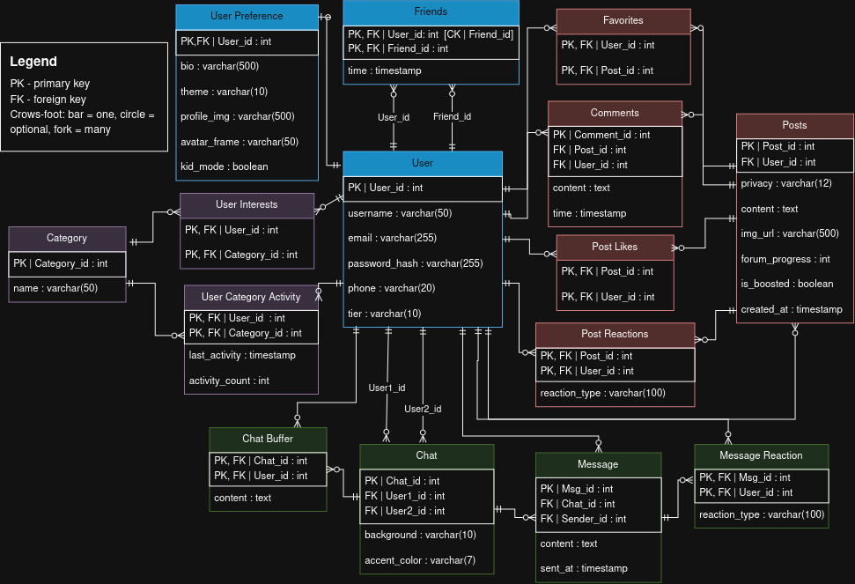
Entity Relationship Diagram
Identity
User, User Preference, Friends
Interests
Category, User Interests, Category Activity
Content
Posts, Comments, Favorites, Likes, Reactions
Messaging
Chat, Chat Buffer, Message, Message Reaction
Notes:
Don't explain every table. Walk the four color groups: Identity (blue), Interests (purple), Content (red), Messaging (green). Point out that interests/category activity feed the personalized feed.

Slide 10
How the ERD Supports Our Features
Posts.forum_progress
Posts.is_boosted
User.tier
Post-to-forum progression
Promoted and personal ads
Free, premium, and business accounts
Preference.kid_mode
Preference.avatar_frame
Posts.privacy
Kids mode
Premium profile customization
Per-post privacy controls
Notes:
Tie the database back to features. Likely Q&A: there is no separate Forum table; a forum is a post whose forum_progress has advanced. Be ready to explain how forum membership and moderators will be handled (e.g. via Chat/Posts relationships or a table added later).

Slide 11
What We Expect to Build
By the end of the semester
How we'll know it works
Accounts, profiles, and a custom dashboard
Post-to-forum progression
Messaging, favorites, and recent activity
Search and an Explore page
Ad and premium accounts
Posts graduating to forums per week
Average forum lifespan
Engagement and user growth rates
User quality surveys
Questions?
Notes:
Restate what the finished product looks like, then open for Q&A. Remember: all questions come after the demo/presentation, and Q&A runs 3-5 minutes.

